Slide 1




HTML
MEDIA

Slide 2
INTRODUCTION
HTML was first developed in the late 1980s by Tim Berners-Lee, a British computer scientist who was working at CERN (the European Organization for Nuclear Research) in Switzerland.
Berners-Lee created HTML as a way to structure and share scientific documents over the internet. He also developed the first web browser, called WorldWideWeb (later renamed to Nexus) and the first web server, called CERN httpd.

Slide 3
What is HTML ?
HTML (Hypertext Markup Language) is a standard markup language used to create web pages. It provides a means to describe the structure and layout of a document, including headings, paragraphs, images, and links. HTML is used in conjunction with other technologies such as CSS and JavaScript to create dynamic and interactive web pages.

Slide 4

MULTIMEDIA
Multimedia on the web is sound, music, videos, movies, and animations.
Multimedia comes in many different formats. It can be almost anything you can hear or see, like images, music, sound, videos, records, films, animations, and more.
Web pages often contain multimedia elements of different types and formats.

Slide 5
Multimedia formats
Multimedia elements (like audio or video) are stored in media files.
The most common way to discover the type of a file, is to look at the file extension.
Multimedia files have formats and different extensions like: .wav, .mp3, .mp4, .mpg, .wmv, and .avi.

Slide 6
There are mainly four 4 media tags in HTML media.
MEDIA TAGS
<Video>
<Audio>
<Object>
<embed>

Slide 7
<VIDEO >
The HTML <video> element is used to show a video on a web page.
To show a video in HTML, use the <video> element
The controls attribute adds video controls, like play, pause, and volume.
It is a good idea to always include width and height attributes. If height and width are not set, the page might flicker while the video loads.
The <source> element allows you to specify alternative video files which the browser may choose from. The browser will use the first recognized format.
The text between the <video> and </video> tags will only be displayed in browsers that do not support the <video> element.
To start a video automatically, use the autoplay attribute

Slide 8
<!DOCTYPE html>
<html>
<body>
<video width="320" height="240" controls>
<source src="movie.mp4" type="video/mp4">
<source src="movie.ogg" type="video/ogg">
Your browser does not support the video tag.
</video>
</body>
</html>

Slide 9


Slide 10
<AUDIO>
The HTML <audio> element is used to play an audio file on a web page.
To play an audio file in HTML, use the <audio> element.
The controls attribute adds audio controls, like play, pause, and volume.
The <source> element allows you to specify alternative audio files which the browser may choose from. The browser will use the first recognized format.
The text between the <audio> and </audio> tags will only be displayed in browsers that do not support the <audio> element.
To start an audio file automatically, use the autoplay.

Slide 11

<!DOCTYPE html>
<html>
<body>
<audio controls>
<source src=“claps.ogg" type="audio/ogg">
<source src=“claps.mp3" type="audio/mpeg">
Your browser does not support the audio element.
</audio>
</body>
</html>

Slide 12
<OBJECT>
The <object> element is supported by all browsers.
The <object> element defines an embedded object within an HTML document.
It was designed to embed plug-ins (like Java applets, PDF readers, and Flash Players) in web pages, but can also be used to include HTML in HTML.

Slide 13
<!DOCTYPE html>
<html>
<body>
<object width="100%" height="500px" data="audi.jpeg"></object>
</body>
</html>

Slide 14
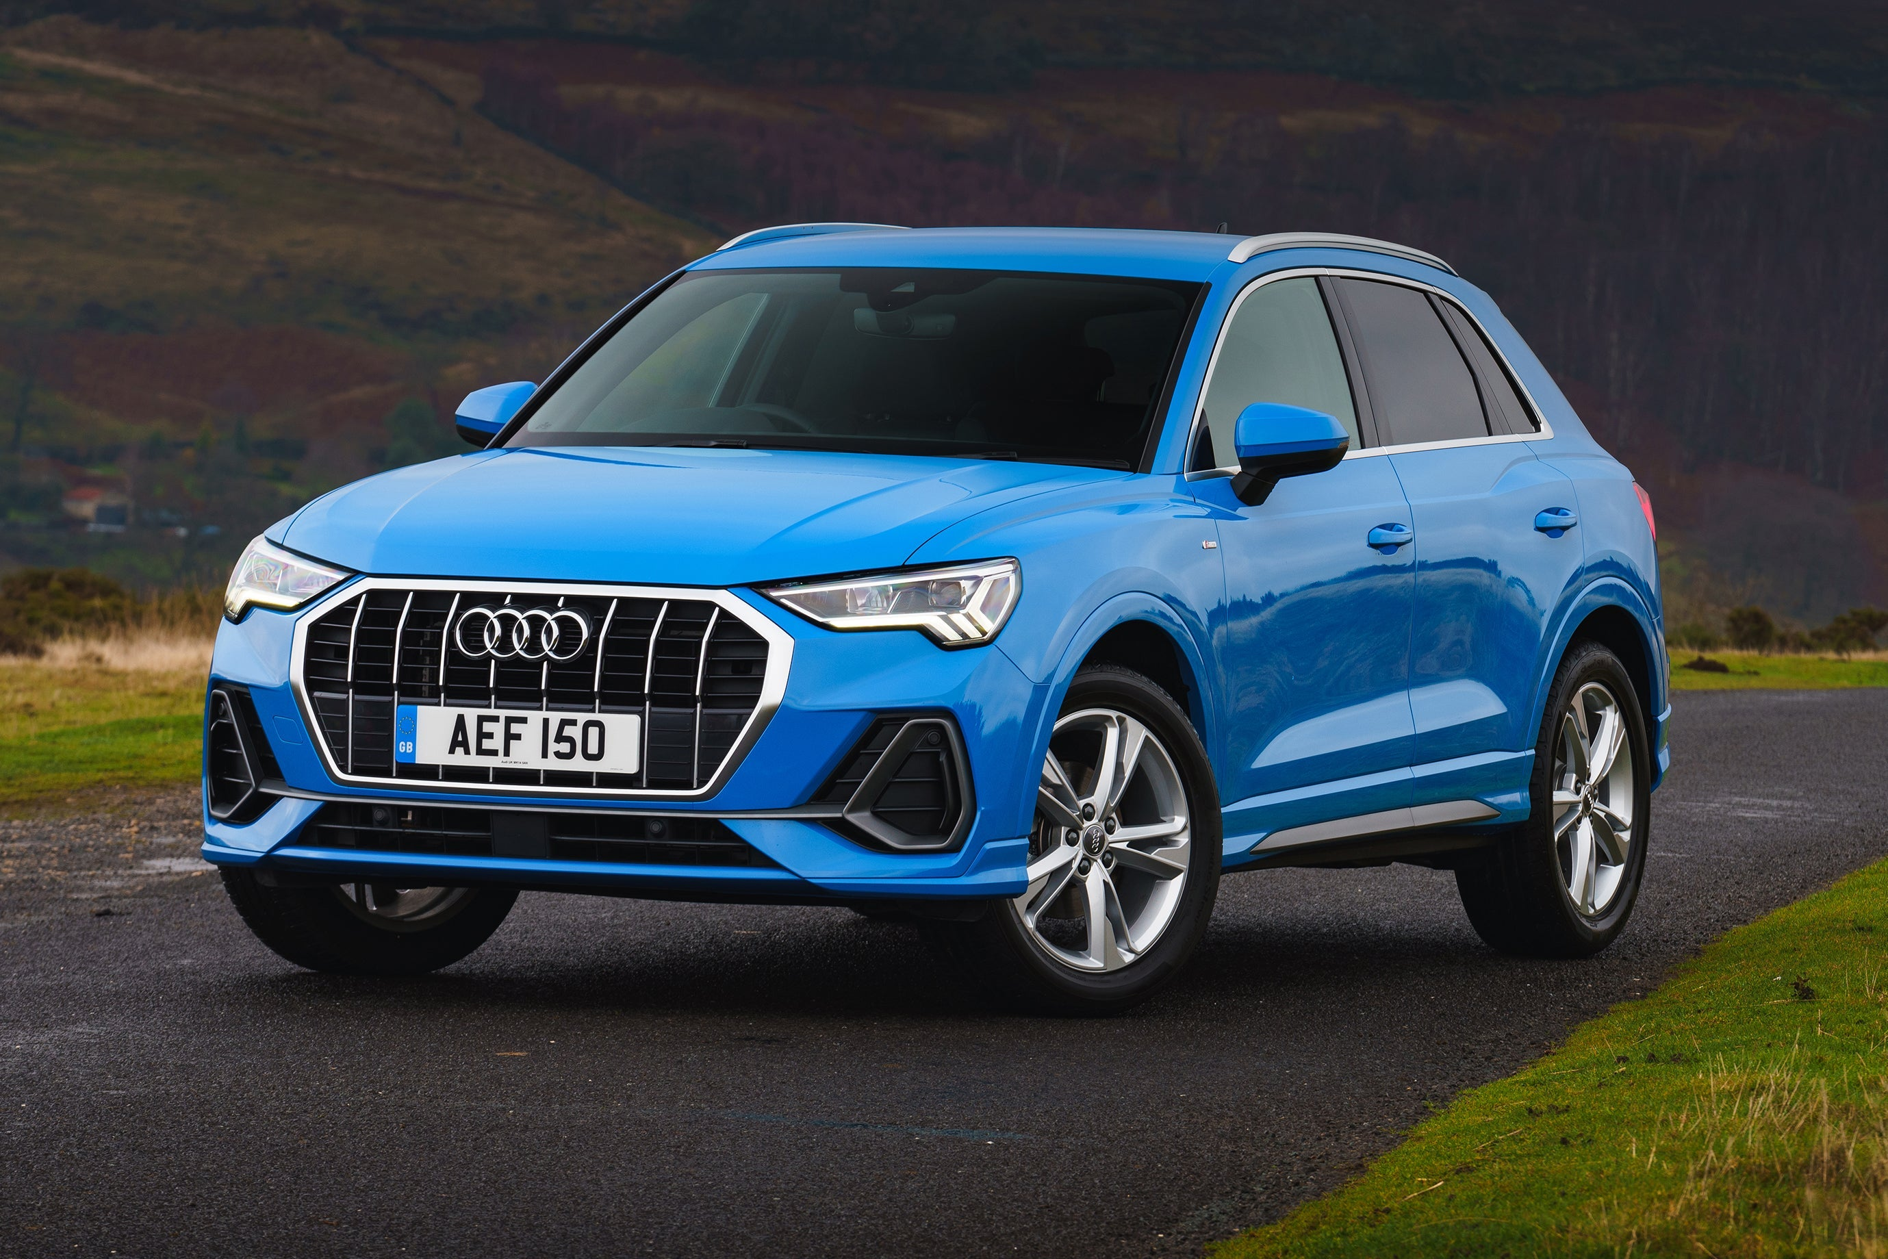

Slide 15
<EMBED>
The <embed> element is supported in all major browsers.
The <embed> element also defines an embedded object within an HTML document.
Web browsers have supported the <embed> element for a long time. However, it has not been a part of the HTML specification before HTML5.

Slide 16
<!DOCTYPE html>
<html>
<body>
<embed width="100%" height="500px" src="snippet.html">
</body>
</html>

Slide 17
Alfreds Futterkiste | Berlin | Germany
Berglunds snabbköp | Luleå | Sweden
Centro comercial Moctezuma | México D.F. | Mexico
Ernst Handel | Graz | Austria
FISSA Fabrica Inter. Salchichas S.A. | Madrid | Spain
Galería del gastrónomo | Barcelona | Spain
Island Trading | Cowes | UK
Königlich Essen | Brandenburg | Germany
Laughing Bacchus Wine Cellars | Vancouver | Canada
Magazzini Alimentari Riuniti | Bergamo | Italy
North/South | London | UK
Paris spécialités | Paris | France
Rattlesnake Canyon Grocery | Albuquerque | USA
Simons bistro | København | Denmark
The Big Cheese | Portland | USA
Vaffeljernet | Århus | Denmark
Wolski Zajazd | Warszawa | Poland

Slide 18
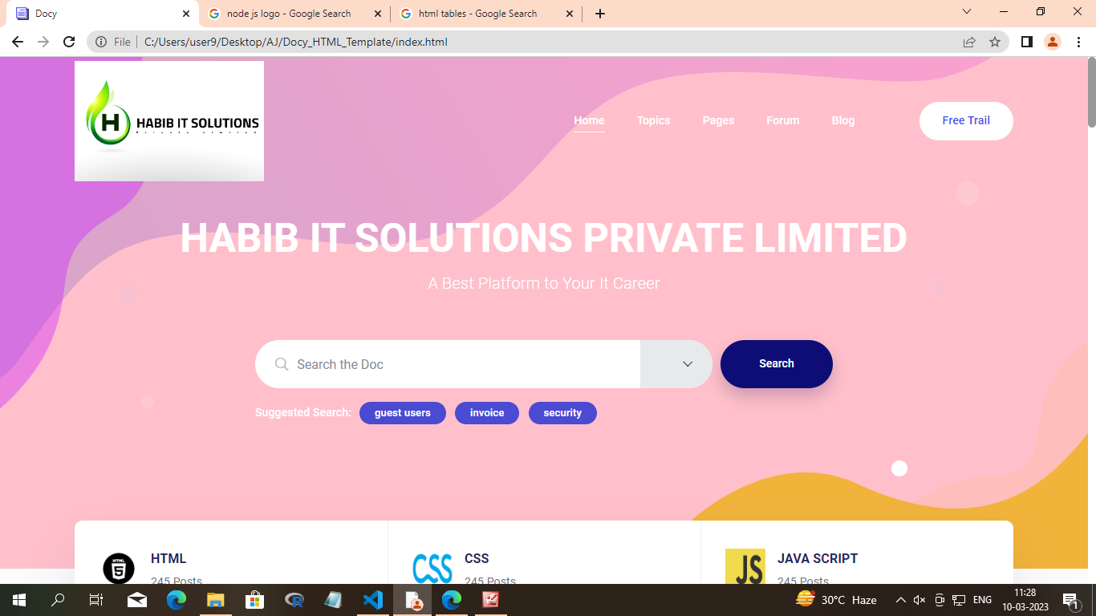

Slide 19
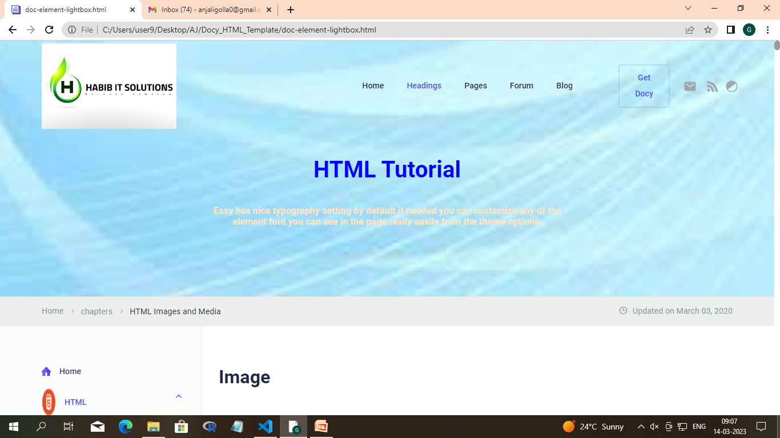

Slide 20
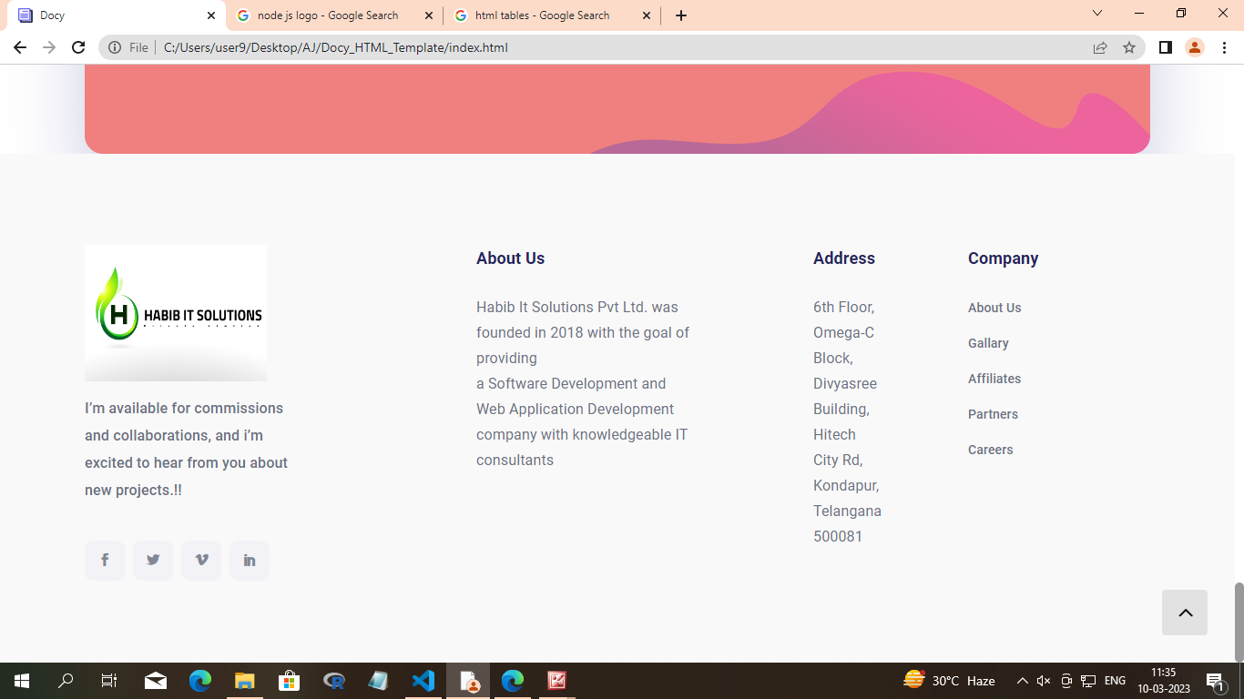

Slide 21
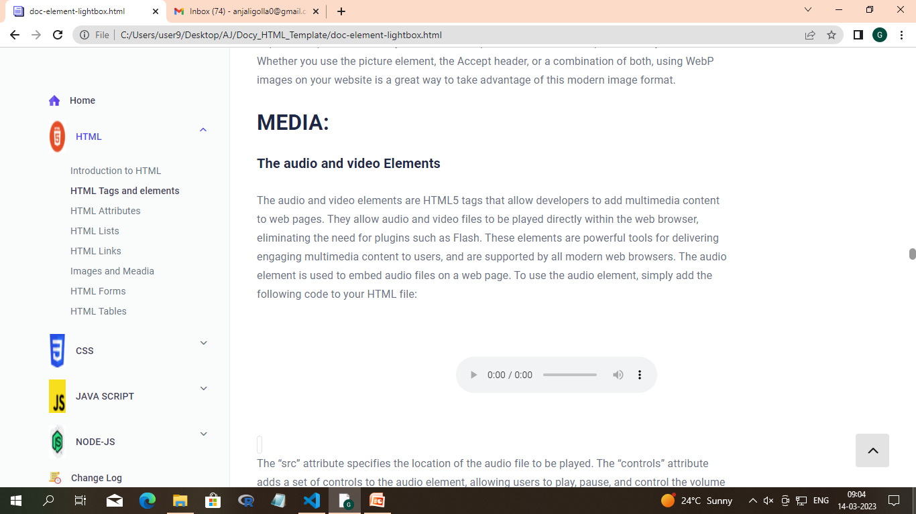

Slide 22
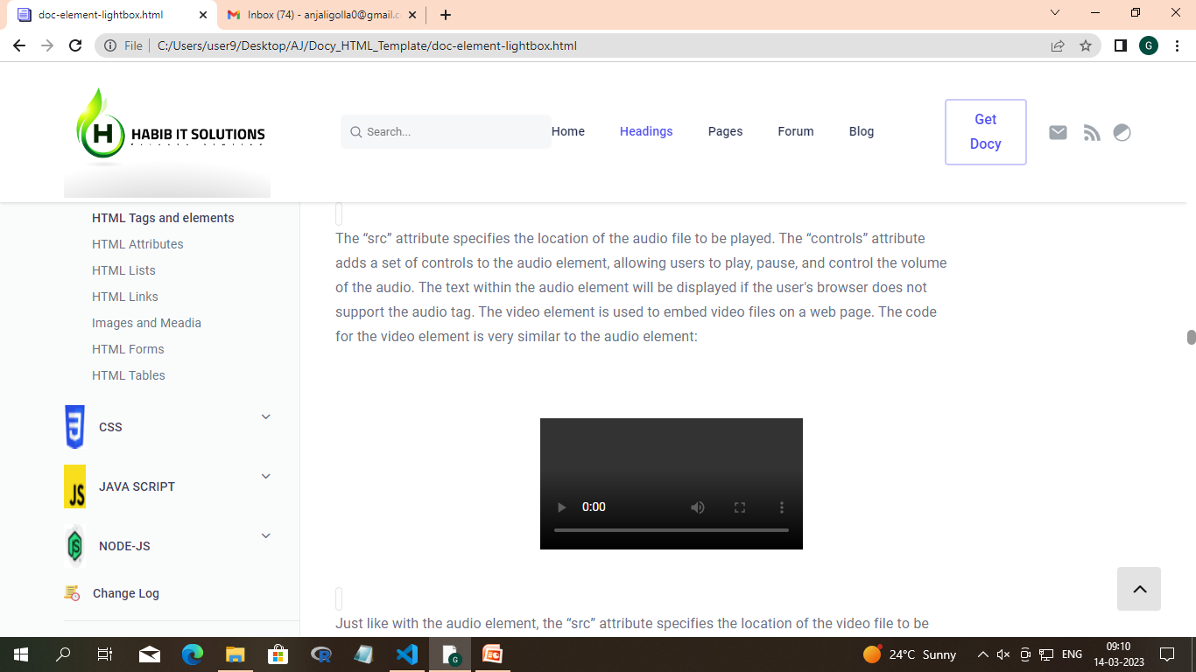

Slide 23
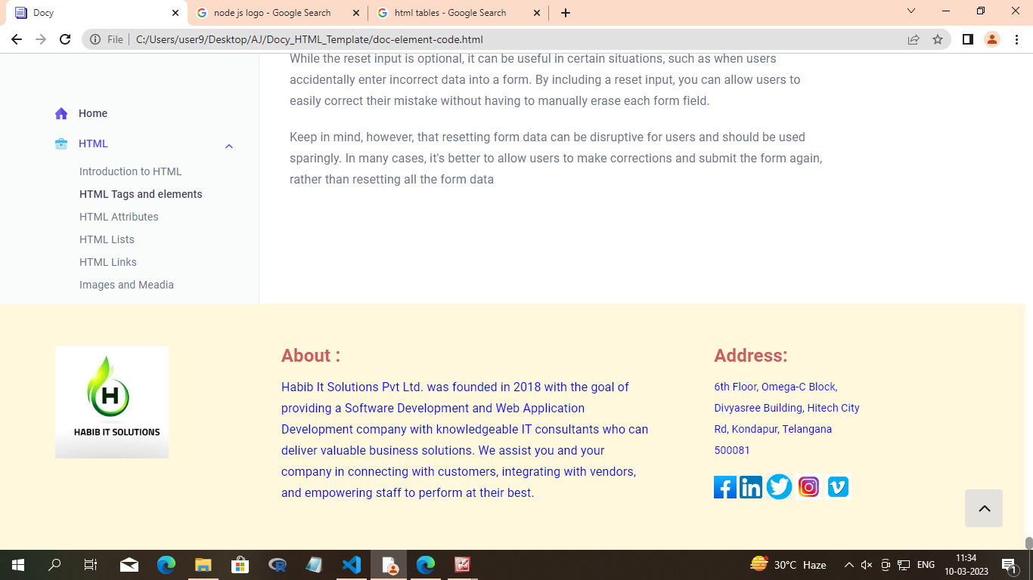

Slide 24
Thank you

